Slide 1
PHS RShiny Dashboard Project
Team Klas

Slide 2
The plan
The team
The problem
The brief
The questions
The project
The KPIs
The tools
The shiny app
The end
Notes:
This is what we are going to talk about today – this is the plan
The team – who are we
The problem – what are we looking at
The brief – what have we been asked to do
The questions – what questions are we specifically looking at
The project – how did we plan and operate
The shiny app – a look at what we made
The end – and an opportunity to ask questions

Slide 3
The Team
Kang Hin Lee
Lucy Burns
Aboubakar Hameed
Seàn Cusick
TEAM KLAS
Notes:
This is what we are going to talk about today – this is the plan
The team – who are we
The problem – what are we looking at
The brief – what have we been asked to do
The questions – what questions are we specifically looking at
The project – how did we plan and operate
The shiny app – a look at what we made
The end – and an opportunity to ask questions

Slide 4
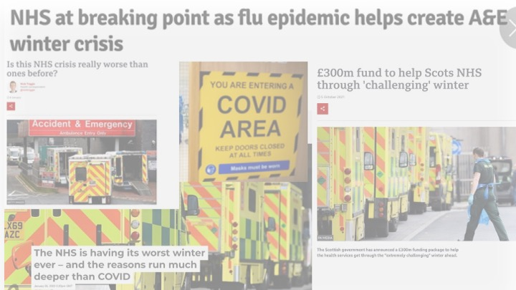
The NHS is in Crisis
Notes:
The Problem
The NHS is in crisis – or so we are led to believe.

Slide 5
The Brief
Create a dashboard using R-Shiny and PHS open data on secondary care to investigate what has been happening from 2020 onwards in the acute hospital sector

Slide 6
Questions
How does Covid affect hospital activity?
How does winter affect hospital activity?
Was there a change post Q1 2020?

Slide 7

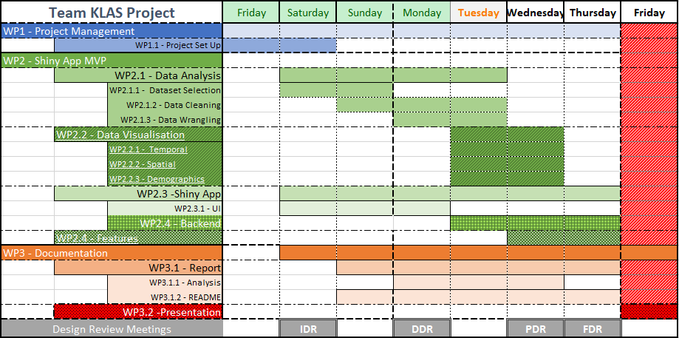


The Project
Methodology
Planning
Datasets
Wrangling
Analysing
Shiny-ing
Conclusions
Shiny App Project
WP1 Project Management Sean
WP3.2 Presentation
WP2 Shiny App
WP3 Documentation Sean
WP1.1 Project Set Up
WP2.1 Data Analysis Kang
WP2.1.1 Dataset Selection
WP2.2 Data Visualisation Lucy
WP2.2.1 Temporal
WP2.1.3 Data Wrangling
WP2.2.2 Spatial
WP2.2.3 Demographics
WP2.3 Shiny App MVP Aboubakar
WP2.3.1 UI
WP2.3.2 Backend
WP2.4 Features
WP3.1 Report
WP3.1.1 Analysis
WP3.1.2 README
WP2.1.2 Data Cleaning

Slide 8
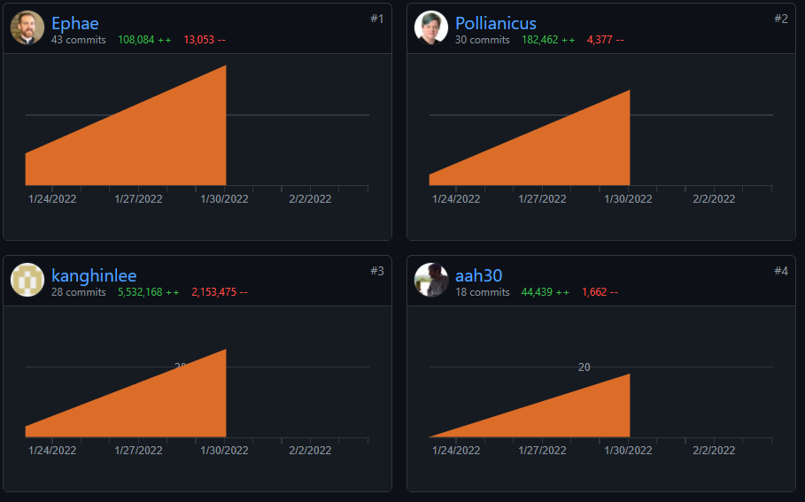
KEY PERFORMANCE INDICATORS
Measurement used to track activities towards a goal.
2 Branch commits per day
1 Branch merges per day
10,000 additions of code per day
2 Stand-Up meetings per day
5 minutes per person in meeting
2 Branch commits
1 Branch merges
10,000 additions
2 meetings
5 minutes

Slide 9
The Tools
Discord
tidyverse
RStudio
CodeClan
GitHub
Shiny
ggplot

Slide 10
The Data
The Aim: Efficiency and Consistency
Extract
Cleaning
Wrangling

Slide 11

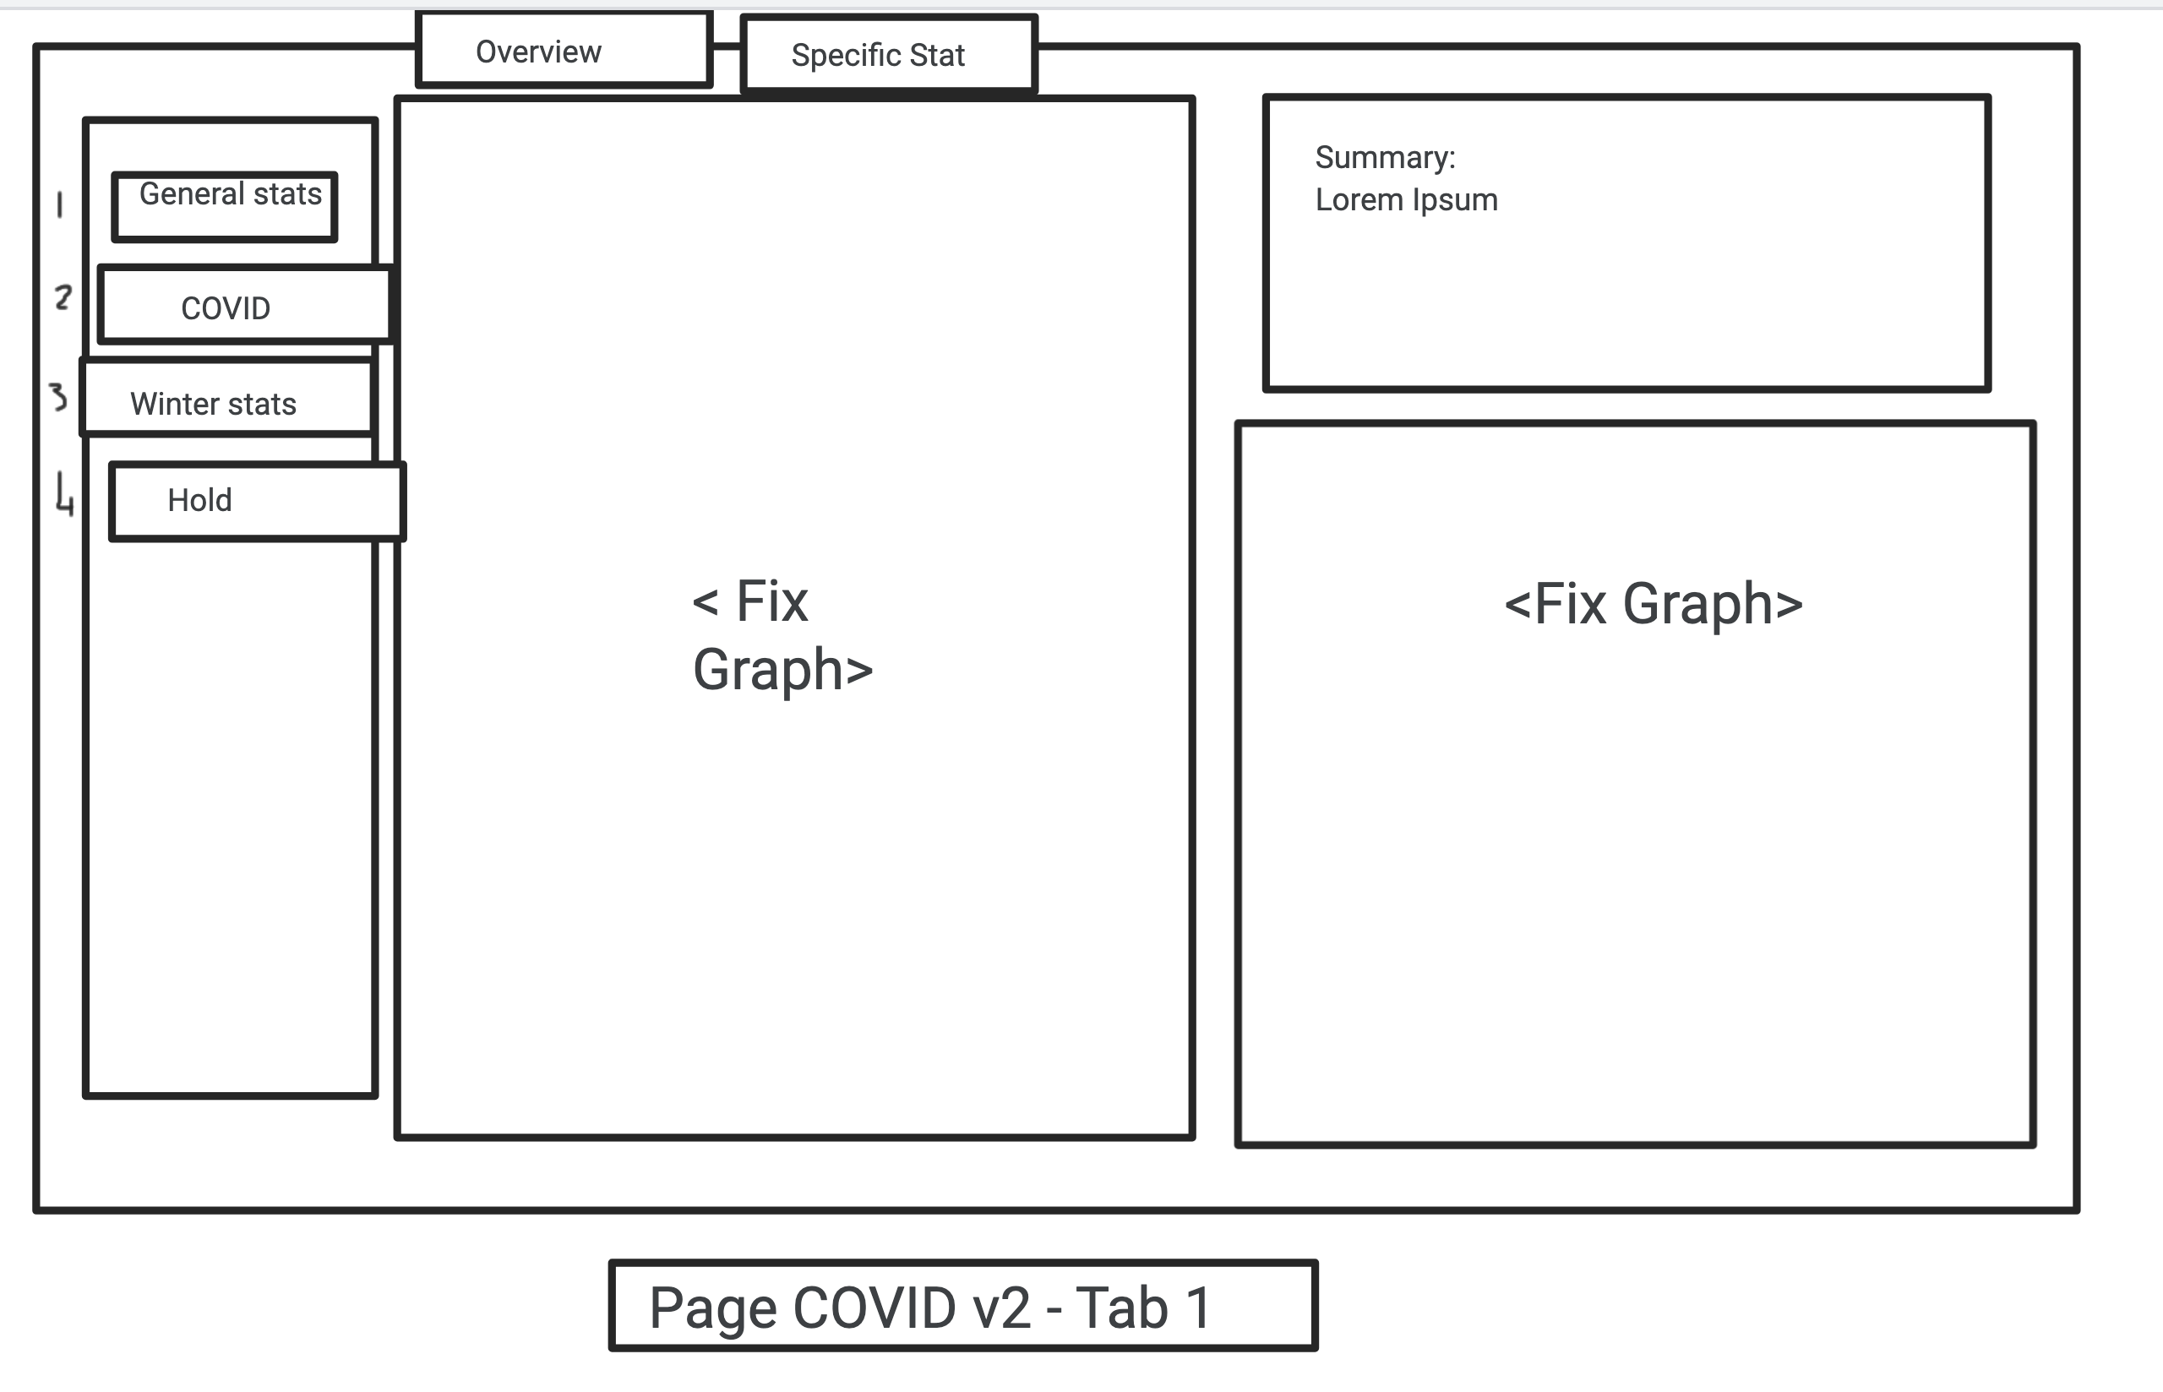
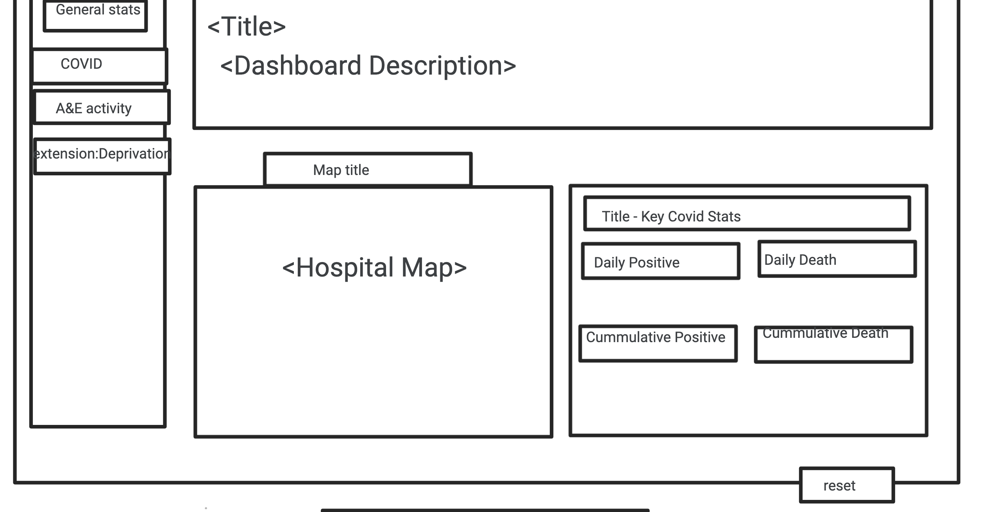
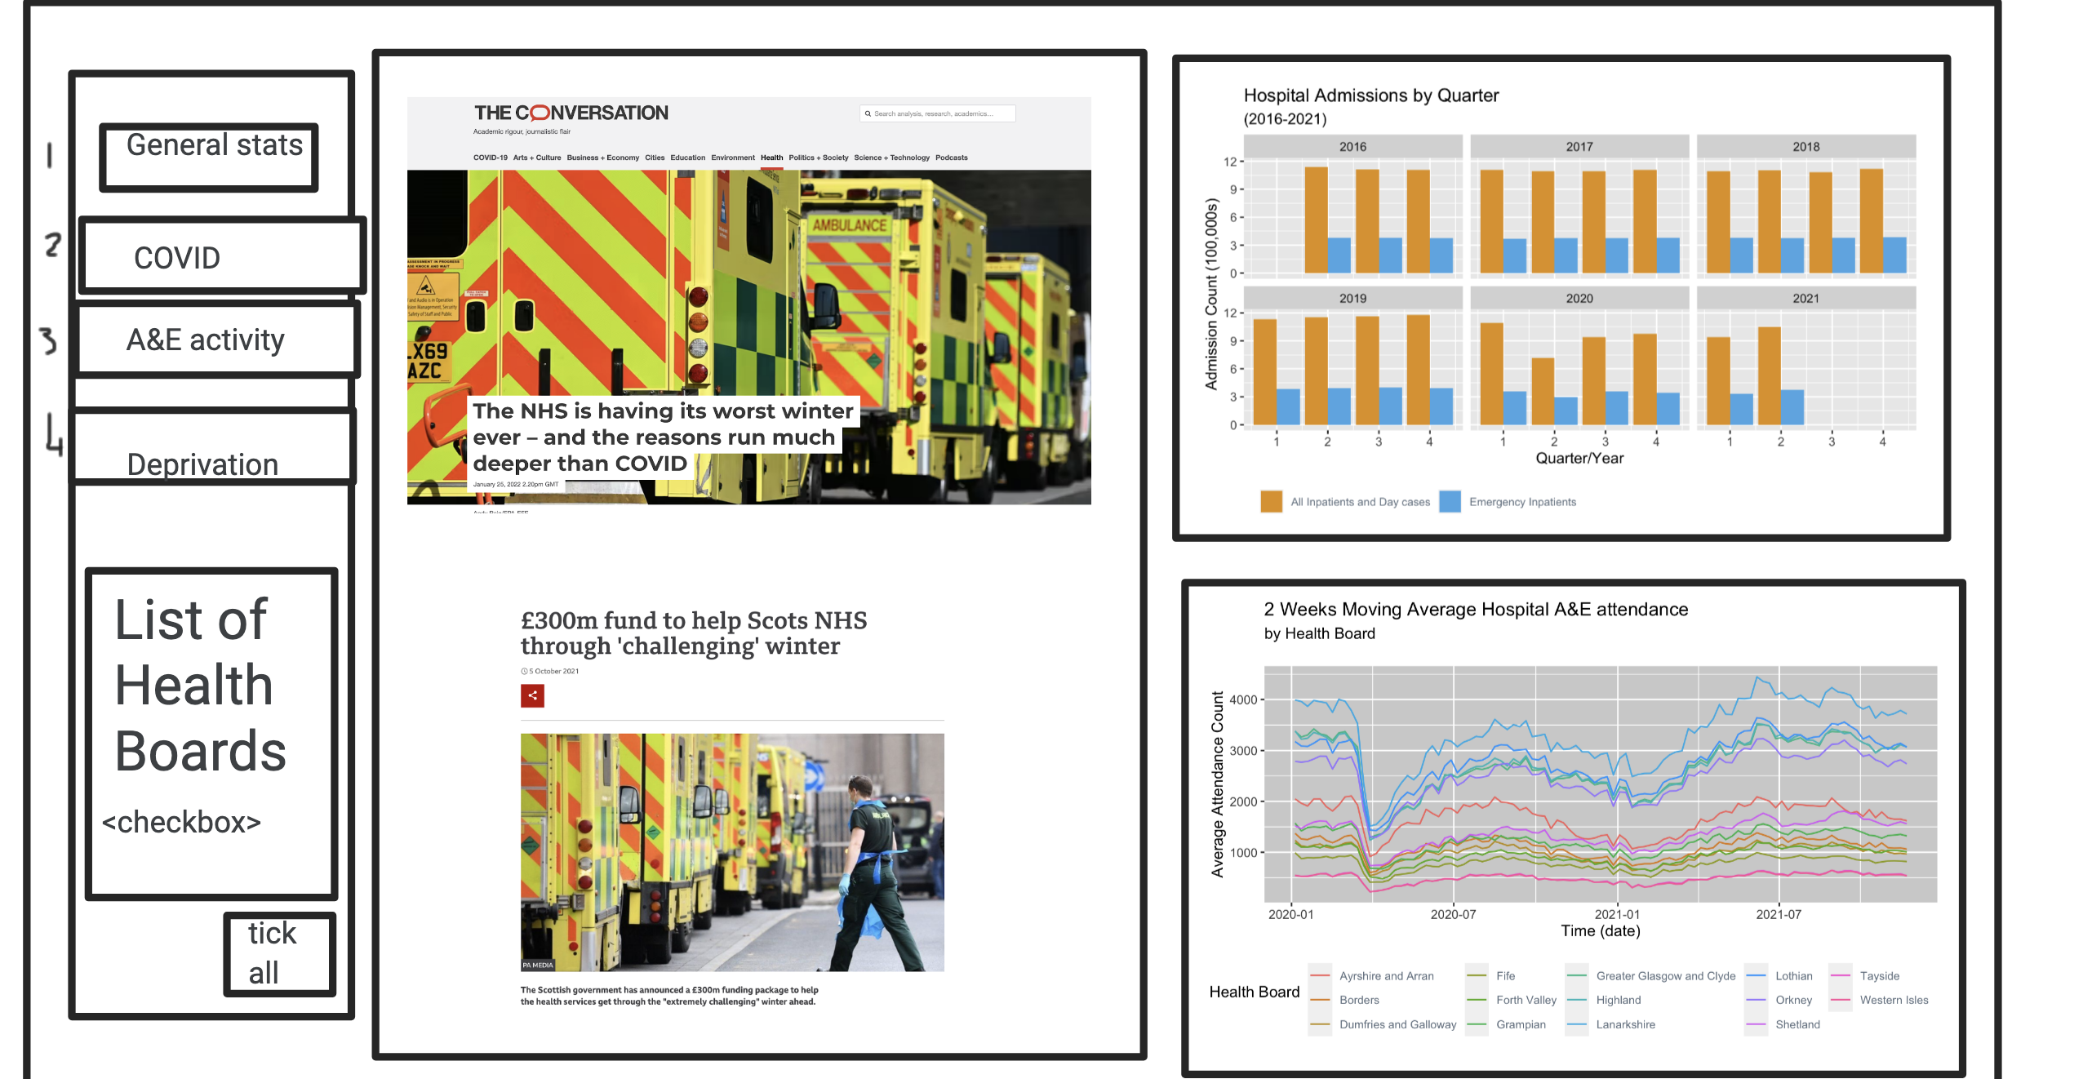

The dashboard
Winter Affectations Post-2020 on Scottish Health Service Application
…from Jamboard wireframes to a Shiny App

Slide 12
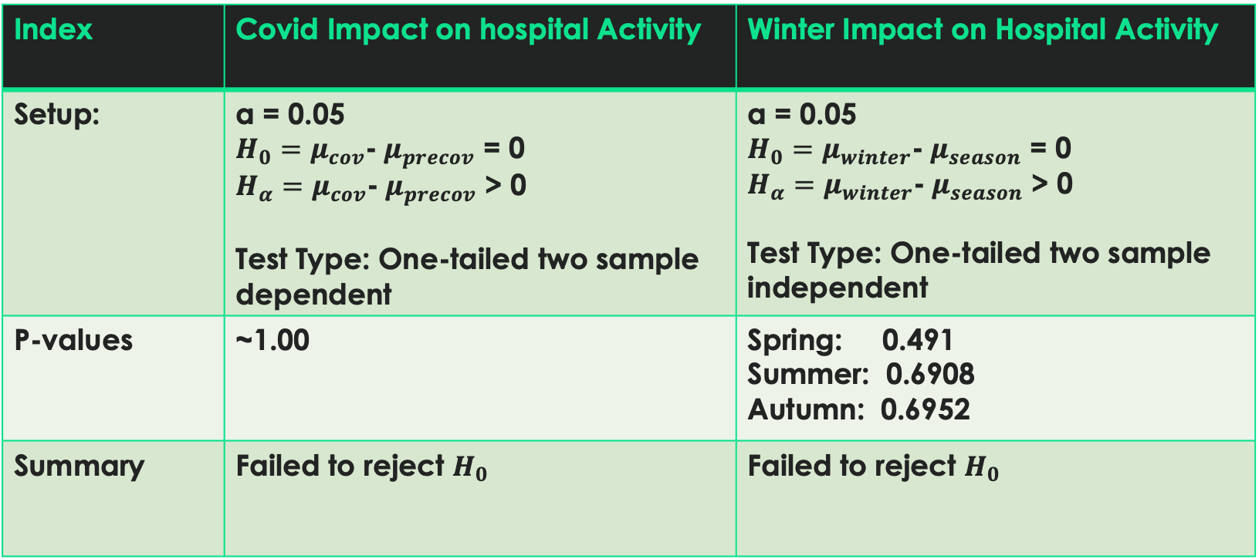
results
Index | Covid Impact on hospital Activity | Winter Impact on Hospital Activity
Setup: | α = 0.05 $H_{0}=μ_{cov}$-$μ_{precov}$ = 0 $H_{α}=μ_{cov}$-$μ_{precov}$ > 0 Test Type: One-tailed two sample dependent | α = 0.05 $H_{0}=μ_{winter}$-$μ_{season}$ = 0 $H_{α}=μ_{winter}$-$μ_{season}$ > 0 Test Type: One-tailed two sample independent
P-values | ~1.00 | Spring: 0.491 Summer: 0.6908 Autumn: 0.6952
Summary | Failed to reject $H_{0}$ | Failed to reject $H_{0}$

Slide 13
The ENd
Any questions?

